Slide 1
PARK PLACE DRIVE
Structure Fire
After Action Review
IC perspective for training development
September 14, 2026
Petaluma Fire Department
Notes:
Source: IC-provided incident notes and after-action briefing content.

Slide 2

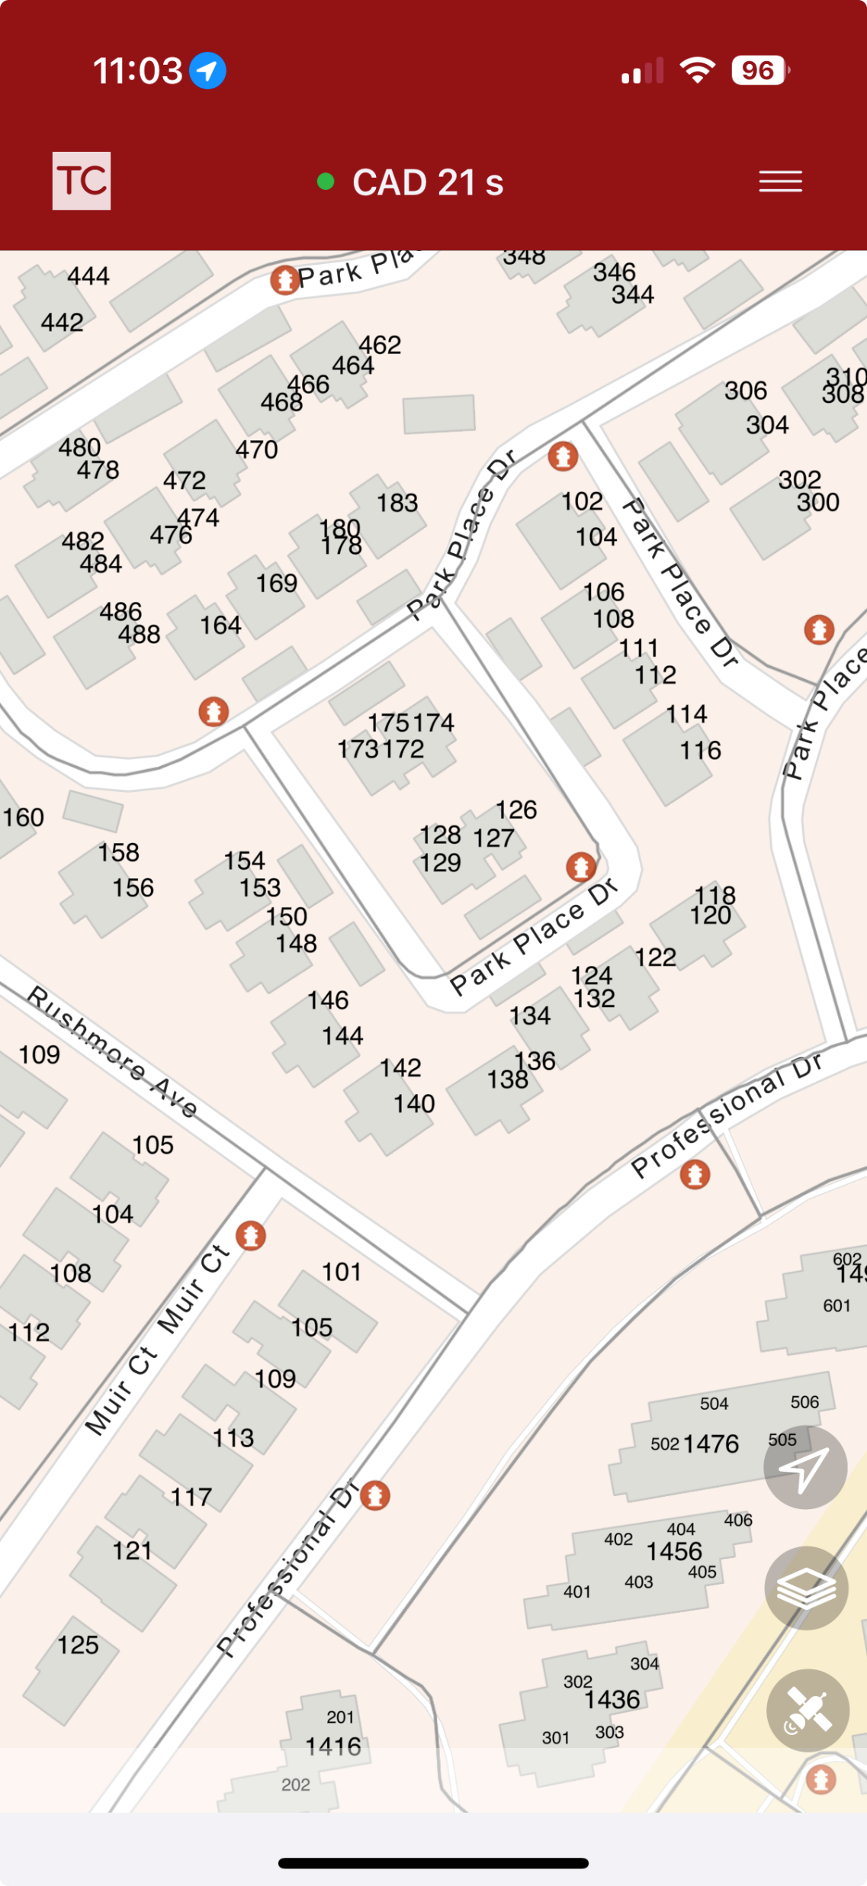
132 Park Place Drive Click to Listen – 911 Caller
02
Building
Two-story side-by-side duplex
Weather
72–74°F
Wind sustained at 14 mph
Gusts to 20 mph
Time of day
16:34
IC perspective • Training development
Notes:
Source: IC-provided incident notes and after-action briefing content.

Slide 3
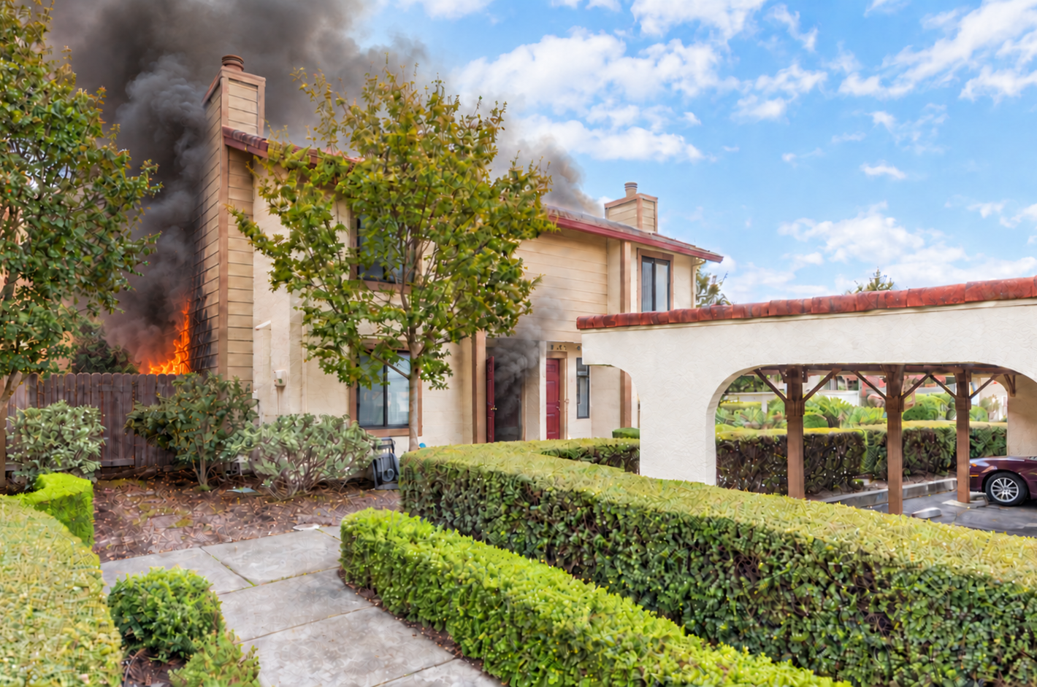
First-arriving conditions
03
Heavy gas-fed fire in the kitchen and rear room
Fire overhead 5–10 feet inside the Alpha entry
Fire out the Bravo kitchen window and likely the Charlie-Bravo patio opening
Siding involved with extension into the attic
Detached Bravo duplex threatened
Interior crews reported extreme heat
Click to Listen –
Report on Conditions – Control 4 Traffic
AI was used in this photo to simulate fire conditions
TRAINING RECONSTRUCTION BASED ON IC DESCRIPTION
IC perspective • Training development
Notes:
Source: IC-provided incident notes and after-action briefing content.
The incident image is a generated training reconstruction, not an incident photograph.

Slide 4
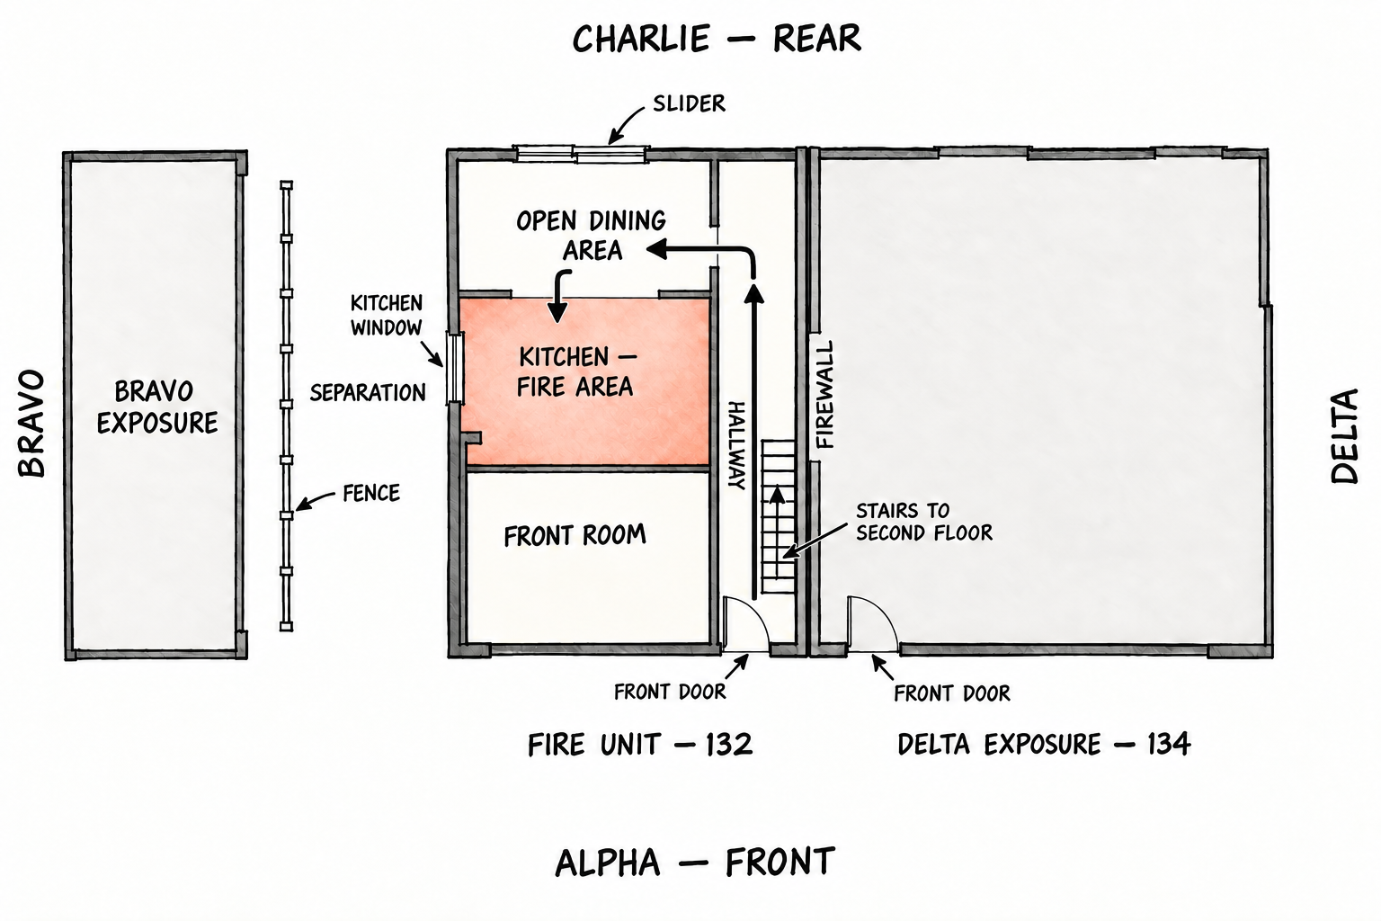
Building layout shaped the attack Click to Listen - Tac 2 Traffic
04
From Alpha, the line moved down the enclosed hall to Charlie, left through the dining area, then left again into the kitchen.
Notes:
Source: IC-provided incident notes and after-action briefing content.

Slide 5
Command priorities
05
01
Life- No reports of people trapped
04
The interior line contained the fire on the first floor - created space for primary search and protected the stairwell
02
Contain the fire - protect the detached Bravo exposure - prevent extension into the attached Delta unit
05
Hose line to the 2nd floor to extinguish the attic fire in coordination with vertical ventilation to prevent lateral spread
03
Establish two-out to support interior attack
06
Secondary searches, rehab, salvage, overhaul, notifications
IC perspective • Training development
Notes:
Source: IC-provided incident notes and after-action briefing content.

Slide 6
Simultaneous operations supported the offensive push
06
INTERIOR ATTACK
BRAVO EXPOSURE
Engine 103 advanced from Alpha toward the kitchen.
Engine 102 flowed parallel with the interior push.
The line protected the second floor, drove fire back toward Bravo-Charlie, and created space for search.
The stream cleaned up siding fire, held the detached duplex, and avoided pushing fire back onto interior crews.
Avoid flowing through open windows from the exterior
IC perspective • Training development
Notes:
Source: IC-provided incident notes and after-action briefing content.

Slide 7
Assignments flexed with the fire
07
Unit | Initial function | How the assignment developed
Engine 103 | Fire attack and supply | Advanced from Alpha toward the kitchen and held the interior
Medic 102 | Two-out and backup | Tracked crews, supported the line, and prepared for rescue
Engine 102 | Bravo exposure | Extinguished exterior fire on the Bravo, moved upstairs, pulled ceiling, and extinguished attic fire
Medic 101 | Primary search | Searched the fire unit under Engine 103 (Fire Attack Group)
Engine 92 | Delta unit | Evacuated, searched, and checked the shared wall and attic
Engine 101 | Vertical ventilation | Opened the tile roof in coordination with the crew
Engine 9787 | Reinforcement | Supported exposure and fire attack operations/ overhaul
Battalion 91 | Safety | Monitored changing conditions and firefighter risk/ obtained initial statements
Battalion 9 | Incident command | Managed incident priorities and operational resources.
IC perspective • Training development
Notes:
Source: IC-provided incident notes and after-action briefing content.

Slide 8
Incident outcome
~20
4
2
minutes to knockdown
residents displaced
duplex units' red tagged
Primary and secondary searches clear
Detached Bravo exposure held
No extension found in attached Delta unit
PG&E secured gas and electrical service
PD handled the road closure and Red Cross assisted residents
Fire Investigation handled by Prevention 93
Crews released in phases to allow for decontamination
Notes:
Source: IC-provided incident notes and after-action briefing content.

Slide 9
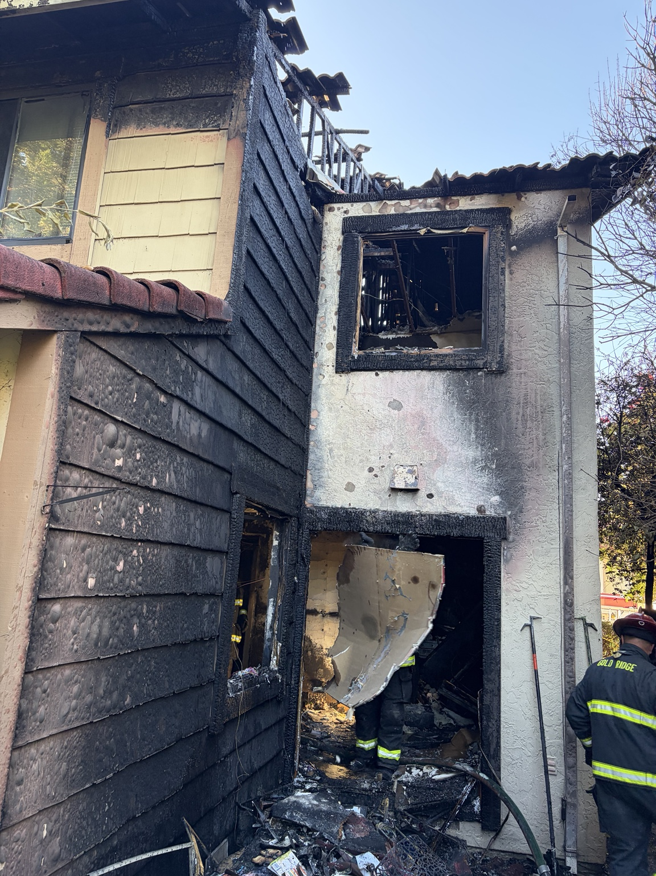
Fire path and structural damage
09
Observed conditions
Fire ran the Bravo siding from the kitchen level into the attic and roof area
Exterior walls and openings showed heavy heat and flame impingement
Roof members were exposed with heavy charring beneath the tile roof
Fire damage and the ventilation opening reduced confidence in the roof system
Red-tag basis
Both duplex units were red tagged due to fire damage, limited attic access, compromised roof support, and tile-roof dead load.
POST-CONTROL INCIDENT PHOTO
IC perspective • Training development
Notes:
Source: IC-provided incident notes and after-action briefing content.
Post-control incident photo supplied by the IC for after-action documentation.

Slide 10
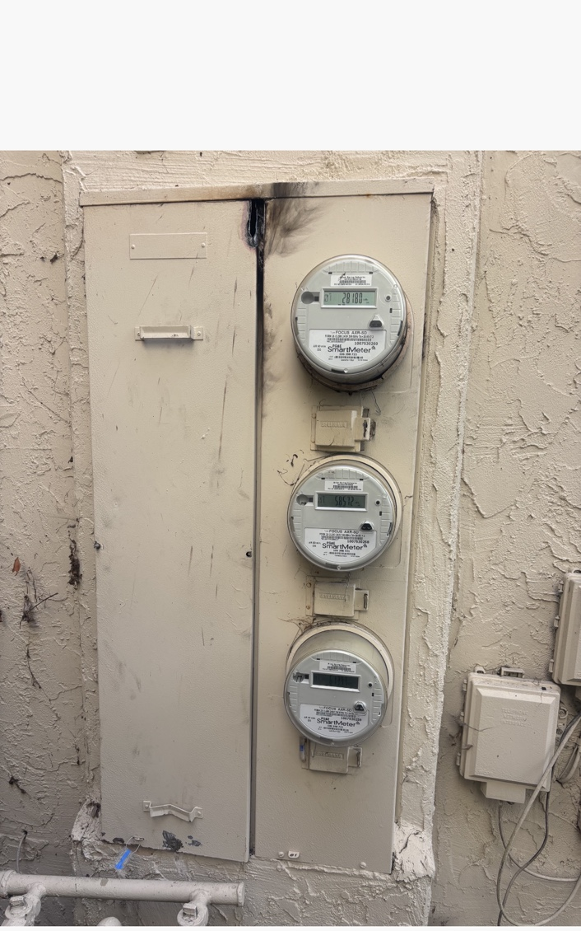
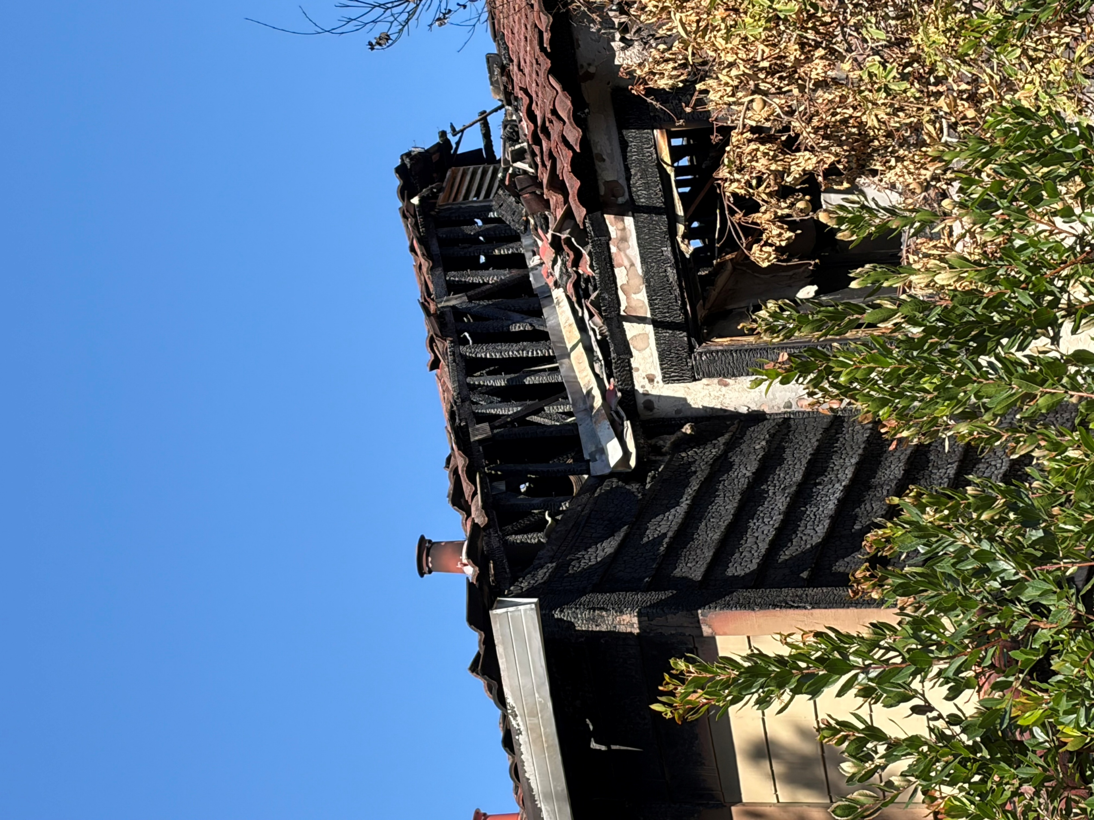
Safety and risk review
10
Electrical near miss
Tile roof and attic fire
The cabinet arced when a firefighter attempted to open it. No injury occurred.
Tile added considerable dead load
Roof members were exposed with heavy charring beneath the tile roof
Training point
Induvial breakers located under each meter.
Arcing and heat damage at the upper cabinet seam
IC perspective • Training development
Notes:
Source: IC-provided incident notes and after-action briefing content.
Electrical meter cabinet photo supplied by the IC for after-action documentation.

Slide 11
Operational discussion points
11
First line
Where would you put the first line and why?
Vent
How could you make ventilation on a tile roof with fire in the attic safer?
Utilities
How would you have secured the electrical?
Resource discipline
Review response plans, avoid cutting in line.
Discussion: What condition would have forced the first strategic change?
IC perspective • Training development
Notes:
Source: IC-provided incident notes and after-action briefing content.
Facilitator prompts: loss of water, ignition of the Bravo exposure, or loss of roof stability.

